Slide 1
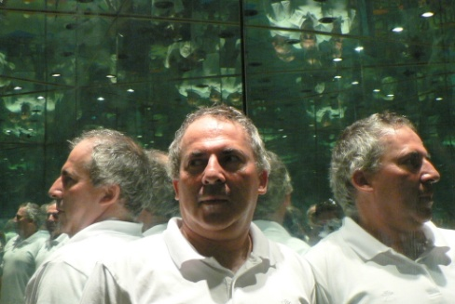






From quantum miracles to many worlds
Lev Vaidman
FQXi Lecture Series on Quantum Foundations 14.3.2018

Slide 2
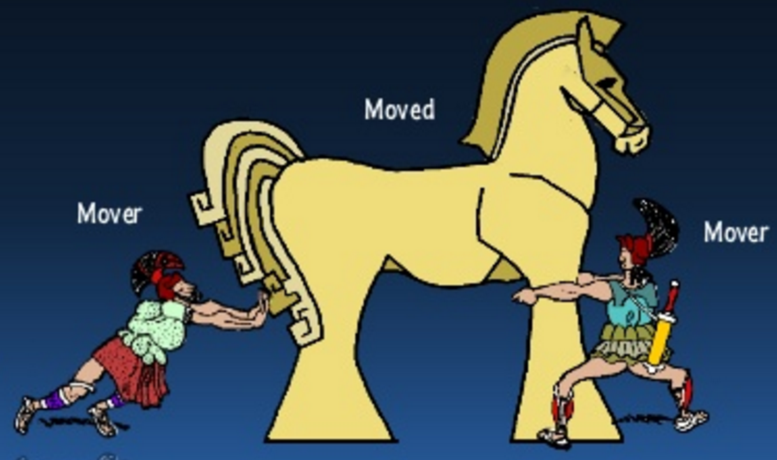
Good explanation
Local action

Slide 3
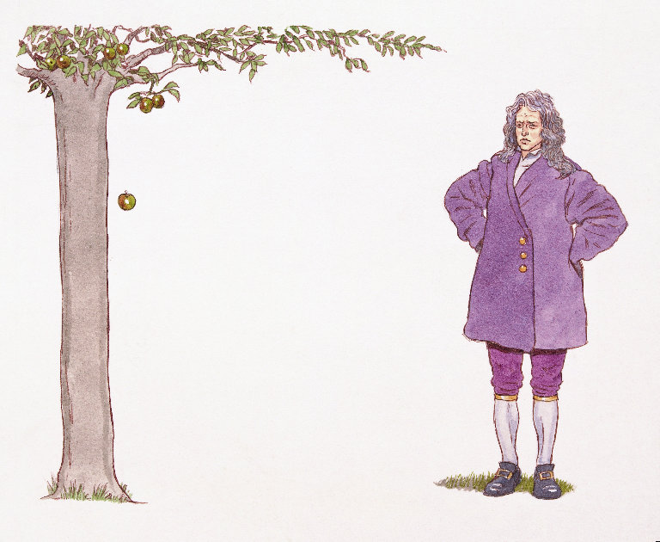
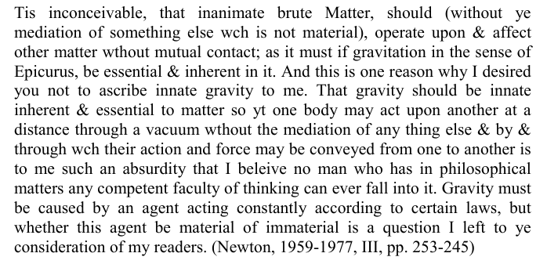
Good explanation
Local action

Slide 4
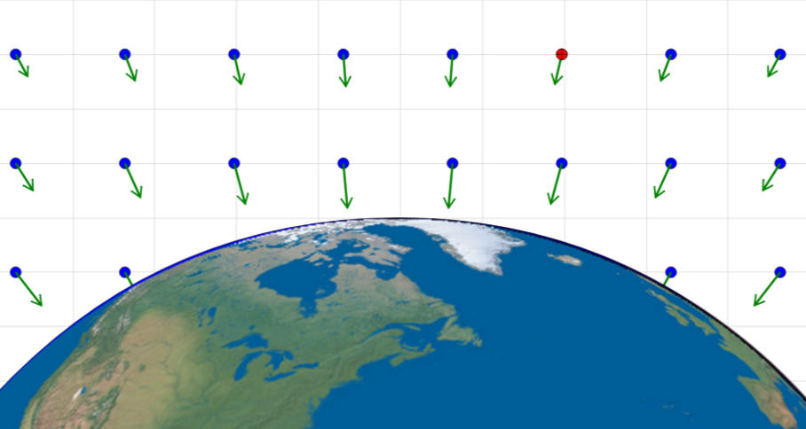

Good explanation
Objects create fields
Fields affect other objects locally

Slide 5
local action
Good explanation
Is it an explanation?
global picture

Slide 6
Classical physics failed to provide an explanation for
Mach Zehnder Interferometer with particles

Slide 7
Quantum mechanics: particles are waves

Slide 8
Quantum mechanics: particles are waves
Quantum physics provides a good explanation:
Local interactions and interference

Slide 9
Aharonov-Bohm Effect: a counter example?!

Slide 10
Aharonov-Bohm Effect: a counter example?!
The solenoid causes a relative phase without classical lag?!
Nonlocality: Electromagnetic potential acts in a global topological way?!
Do we have only global explanation ?

Slide 11

Aharonov-Bohm Effect: a counter example?!
The solenoid causes a relative phase without classical lag?!
Nonlocality: Electromagnetic potential acts in a global topological way?!
Role of Potentials in the Aharonov-Bohm Effect
L. Vaidman, Phys. Rev. A R86, 040101 (2012)
No!
Do we have only global explanation ?
AB effect does have local explanation if everything, including the source of the magnetic flux is treated quantum mechanically
The AB phase is acquired by the solenoid, entangled with the electron, due to local action of electromagnetic field of the electron
Quantum physics provides a good explanation:
Local interactions, interference and entanglement

Slide 12
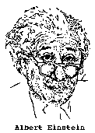


The EPR argument

Slide 13
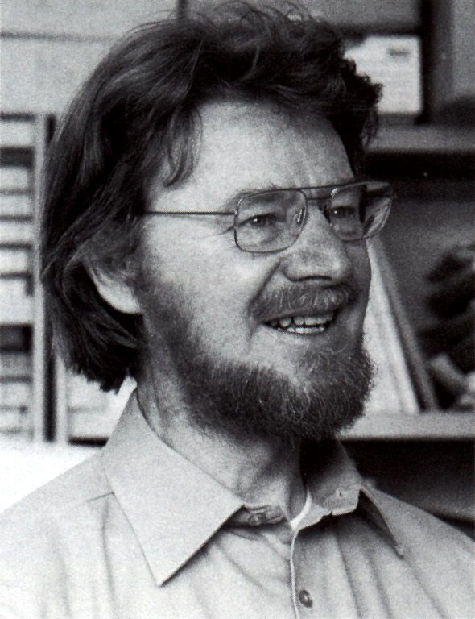
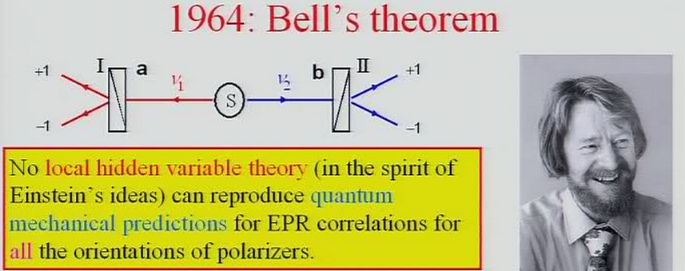
Bell: Quantum theory cannot be completed
Quantum theory has miracle: action at a distance

Slide 14
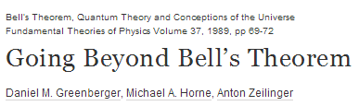
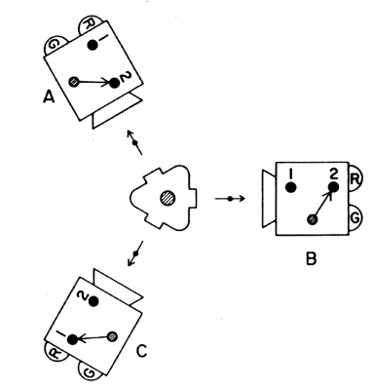
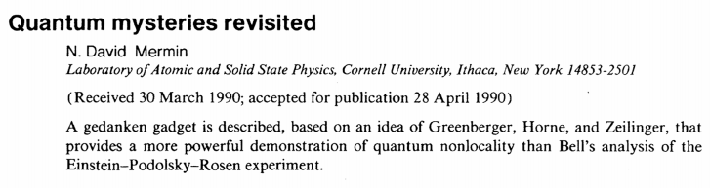
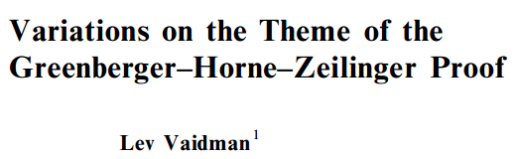
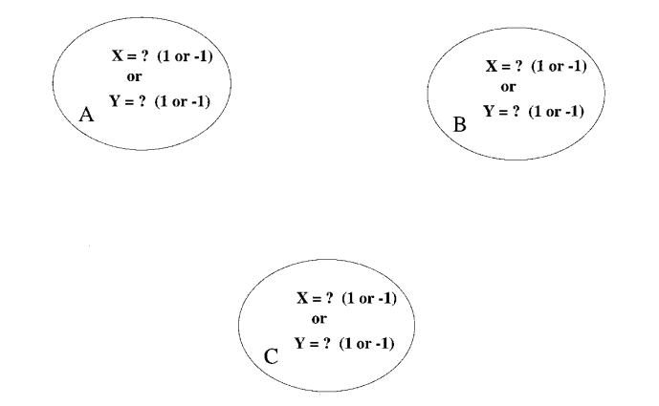

Slide 15



The GHZ game
B
X=?
Y=?
or
1 or -1
Winning conditions
C
A
X=?
Y=?
or
X=?
Y=?
or
1 or -1
1 or -1

Slide 16
The GHZ Game Quantum Strategy
B
X=?
Y=?
or
X
Y
A
C
X=?
Y=?
or
X=?
Y=?
or

Slide 18
The GHZ Game Quantum Strategy
B
X=?
A
C
X=?
X=?
Miracle: change of a spin state by remote action

Slide 19

Teleportation

Slide 20


Teleportation

Slide 21
Teleportation
Science Fiction: Matter cannot “jump” in space time

Slide 22

Teleportation
Science Fiction: Matter cannot “jump” in space time
Quantum mechanics: We do not have to move matter
All matter is the same. We need to move only the shape, the quantum wave function Ψ
= Ψ

Slide 23
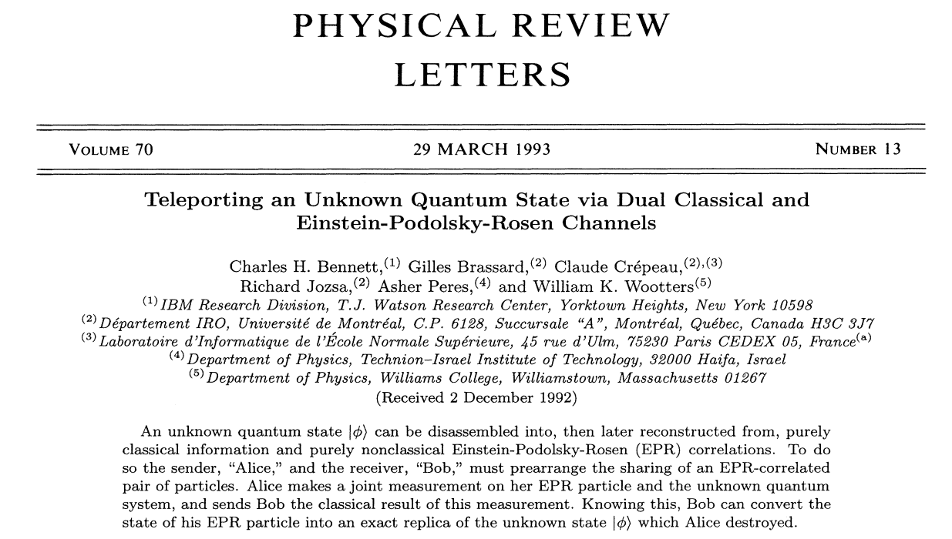
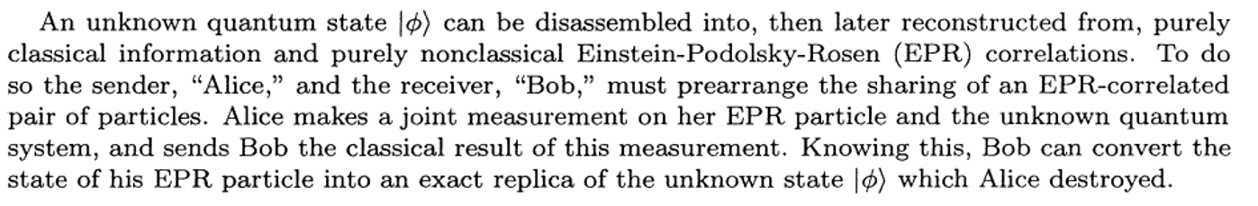
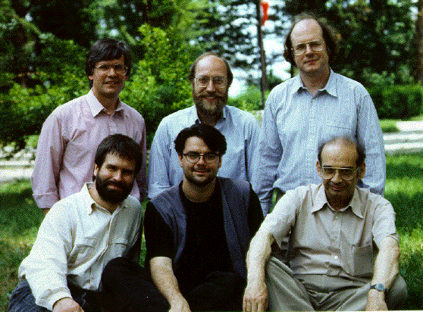
Teleportation

Slide 24
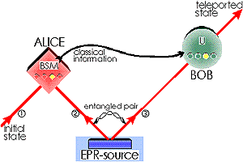
Teleportation
2 bits
BELL MEASUREMENT

Slide 25
Bell States
spin rotation
spin rotation

Slide 26
2 bits
BELL MEASUREMENT

Slide 27
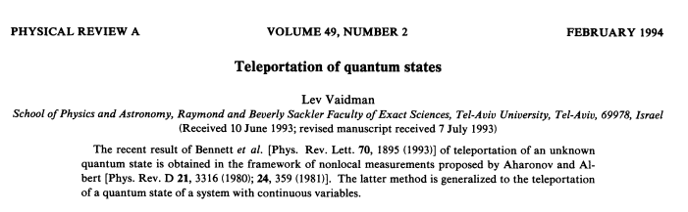
Continuous Variables Teleportation

Slide 28
Teleportation
2 numbers
BELL MEASUREMENT
=Ψ of particles

Slide 29
Teleportation
θ, φ
2 bits
BELL MEASUREMENT
θ, φ
Miracle: sending 2 real numbers with just 2 bits

Slide 30
THE PARADOX OF
THE INTERACTION-FREE MEASUREMENT
A. Elitzur and L. Vaidman
Found. Phys. 23, 987 (1993) .

Slide 31
BOMB:
explodes when any particle “touches” it
interacts only through explosion
HOW TO FIND BOMB WITHOUT EXPLODING IT?
QUANTUM MECHANICS SOLVES THIS [ PARADOX

Slide 32
Interaction-free measurement

Slide 33
Interaction-free measurement

Slide 34
Interaction-free measurement

Slide 35
Interaction-free measurement

Slide 36
Interaction-free measurement
We know the bomb is there
Nothing touched the bomb: PARADOX!

Slide 38
MWI
plato.stanford.edu/entries/qm-manyworlds/
I. The fundamental ontology:
All is evolving according to the relativistic generalization of the Schrodinger equation
II. The connection between ontology and experience:
There are multiple worlds similar to the one we experience.
The experience of an observer in a world is completely specified by the textbook (collapsing) wave function .
Quantum states of all macroscopic objects are Localized Wave Packets
Alternatively, is defined by .
BORN-VAIDMAN RULE:
The probability of self-location of an observer in a particular world is proportional to its measure of existence

Slide 39
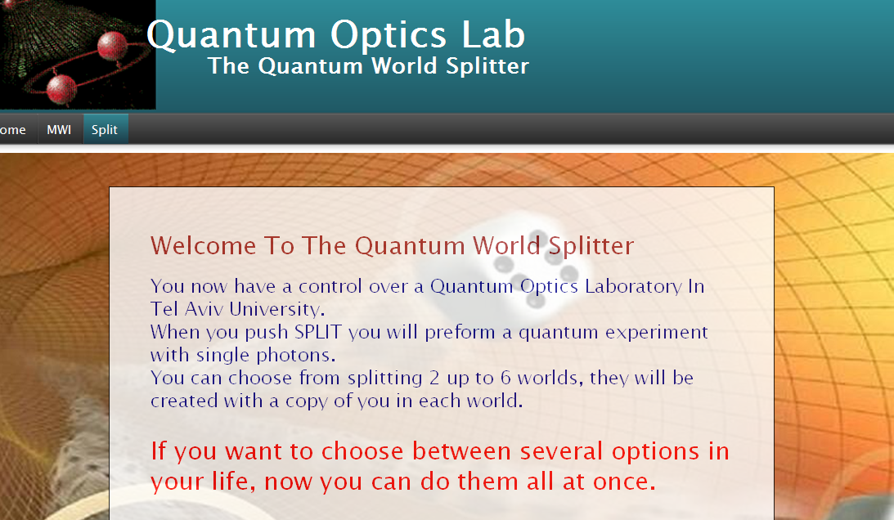

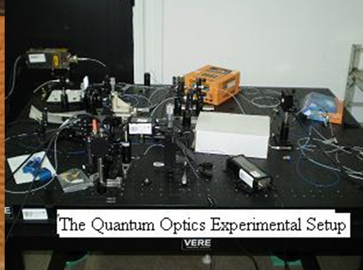
http://qol.tau.ac.il/TWS.html
The Quantum World Splitter
Choose how many worlds you want to split by pressing one of the red dice faces.

Slide 40
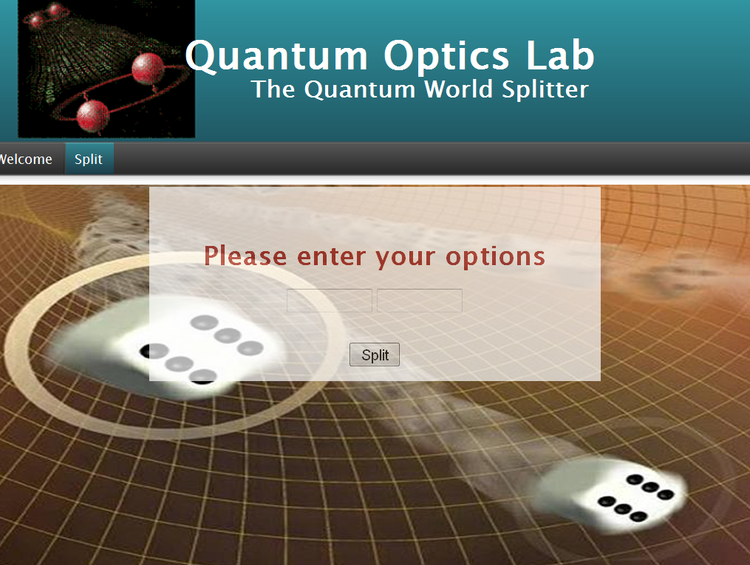
http://qol.tau.ac.il/TWS.html
left
right

Slide 41
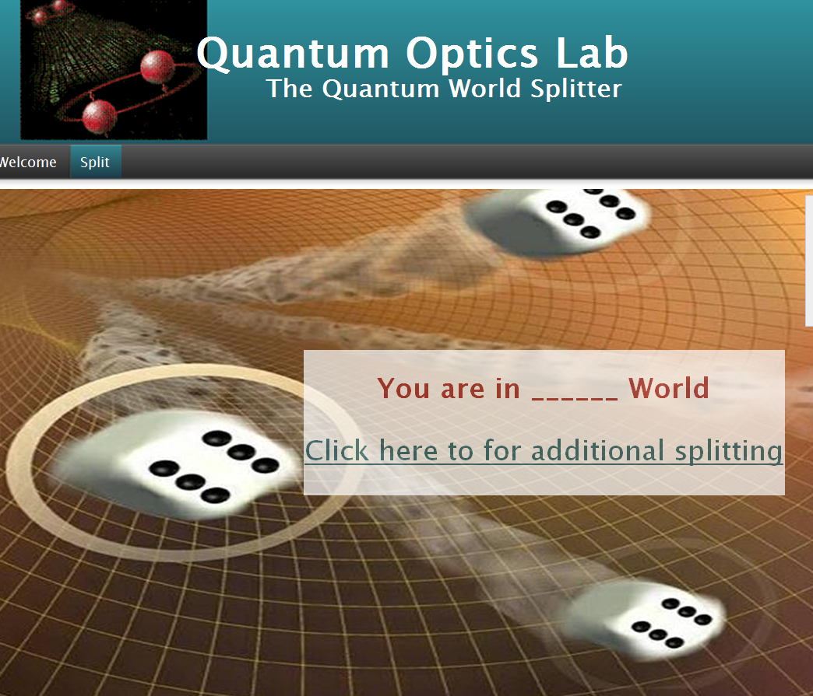
http://qol.tau.ac.il/TWS.html
right

Slide 42
World-splitter of Tel Aviv University

Slide 43
World-splitter of Tel Aviv University

Slide 44
Two worlds universe

Slide 45
Two worlds universe
One world does not disturb the other

Slide 46
Two worlds universe
One world does not disturb the other

Slide 47
Test of the MWI

Slide 48
Test of the MWI

Slide 49
The GHZ Game Quantum Strategy
B
X=?
A
C
X=?
X=?
Miracle: change of a spin state by remote action

Slide 50
The GHZ Game Quantum Strategy
B
X=?
A
C
X=?
X=?
Miracle: change of a spin state by remote action

Slide 51
The GHZ Game: the universe picture
B
X=?
A
C
X=?
X=?
Miracle: change of a spin state by remote action
No miracle: no change of the remote spin

Slide 52
The GHZ Game: the universe picture
B
X=?
BEFORE
A
C
X=?
X=?
Miracle: change of a spin state by remote action
No miracle: no change of the remote spin

Slide 53
The GHZ Game: the universe picture
B
X=?
AFTER
A
C
X=?
X=?
Miracle: change of a spin state by remote action
No miracle: no change of the remote spin

Slide 54
Teleportation
2 bits
BELL MEASUREMENT

Slide 55
2 bits
BELL MEASUREMENT

Slide 56
Interaction-free measurement
We know the bomb is there
Nothing touched the bomb: PARADOX!

Slide 57
Interaction-free measurement

Slide 58
The many worlds picture
Nothing touched the bomb in our world!
The photon touched the bomb in another world
Our intuition comes from physics which describes all worlds together: NO PARADOX!

Slide 59
Conclusions
Bell theorem (GHZ(: The nature is apparently random and it has some kind of action at a distance
Teleportation transfers huge amount of (unreadable) information using a few bits
IFM provides information about presence of an object in a particular location without any particle being there
The MWI removes randomness and action at a distance from physics explaining why we have an illusion of randomness and Bell nonlocality

